Slide 1

Unit-4 Introduction to NoSQL & Basic MongoDB Operations
Database Management System-II (DBMS-II)
#2301CS401
Prof. Firoz A. Sherasiya
Computer Science & Engineering Department
firoz.sherasiya@darshan.ac.in
9879879861

Slide 2

Looping
Outline
Introduction to NoSQL
Types of NoSQL databases
Advantages & Disadvantages of NoSQL
When should NoSQL be used
Introduction to MongoDB
RDBMS v/s MongoDB
Basic Database Commands, Operations & Methods

Slide 3
Introduction to NoSQL
Section – 1

Slide 4
Introduction to NoSQL
NoSQL database technology is designed to store and retrieve data in a non-relational manner.
NoSQL database technology stores data/information in documents instead of columns and rows used by relational databases.
NoSQL stands for “not only SQL” rather than “no SQL” at all.
It is also called as “non SQL” or “non relational SQL”.
NoSQL databases are generally used for handling large volumes of unstructured or semi-structured data, such as documents, graphs, key-value pairs, time series data.
These databases offers high performance, horizontal scalability, and fault tolerance, making them well-suited for modern applications with high data loads and dynamic schemas.
Name | City | Gender
Raj | Rajkot | Male
Jiya | Junagadh | Female
{
“Name”:”Raj”,
“City”:”Rajkot”,
“Gender”:”Male”
}
{
“Name”:”Jiya”,
“City”:”Junagadh”,
“Gender”:”Female”
}

Slide 5
Introduction to NoSQL (Cont..)
With reference to SQL RDBMS-based databases like MS Access, MS SQL Server, MySQL, MariaDB, PostgreSQL and SQLite, NoSQL is totally different.
The concept of the RDBMS is a table-based database, where each data is arranged in tabular relations(format), especially in the Primary Key (PK) and Foreign Key (FK) columns.
In NOSQL, it does not require a schema and does not have table relations, so it is more flexible.
NoSQL databases continue to increase in number of uses, especially in big data implementations and real-time web applications.

Slide 6
What is NoSQL?
SQL is an acronym for Structured Query Language, which is a database concept composed of schemas, tables, columns, and rows.
The query or syntax for calling data in SQL databases makes use of the table relation media.
Multiple sets of data from different tables can be called simultaneously.
The tables in an SQL database are a set of solid and fixed tables.
Therefore, a slight change in the structure of one table may result in the failure of a query that has been programmed in the View or Trigger section.
NoSQL (Non SQL) is a concept and a flexible database model.
In general and specifically NoSQL does not follow the rules of a relational database (RDBMS).
NoSQL does not use the SQL query language.
It provides a mechanism for storage and retrieval of data other than tabular relations model used in relational databases. NoSQL database doesn't use tables for storing data.
It is generally used to store big data and real-time web applications.

Slide 7
Types of NoSQL databases
Section – 2

Slide 8
Types of NoSQL Databases
There are four popular types of NoSQL database systems, each uses a different type of data model:
Key-value (KV) store
Document-based
Column-based
Graph-based

Slide 9
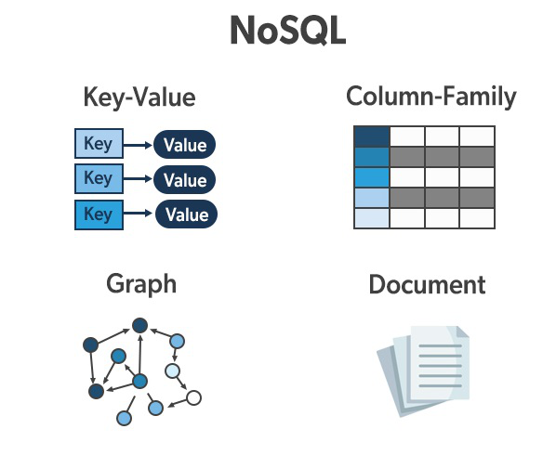
Key-Value (KV) store
In Key-values database, as the name suggests, data is stored as a key and a value pair consisting of an attribute name (or "key") and a value.
Example:
In the above example, a key-value pair can consist of a key ‘Name’, ‘City’ and ‘Gender’ with an associated value ‘Raj’, ’Rajkot’ and ‘Male’.
Values can be stored in several formats, including string, JSON (JavaScript Object Notation), or BLOB (Binary Large Object).
Key-value pair NoSQL is conceptually based on hash tables using a unique key and a pointer to a specific data item.
Name
Raj
Name | City | Gender
Raj | Rajkot | Male
City
Rajkot
Gender
Male
Examples:
DynamoDB
Redis
Cassandra

Slide 10
Document-based
Document-based database stores and retrieves data as a key value pair but the value part is stored as a document.
The document is stored in JSON or XML formats.
Example:
In a document database, documents can be nested.
Particular elements can be indexed for faster querying.
Name
Raj
{
“Name”:”Raj”,
“City”:”Rajkot”,
“Gender”:”Male”
}
Name | City | Gender
Raj | Rajkot | Male
City
Rajkot
Gender
Male
Examples:
OrientDB
CouchDB
MongoDB

Slide 11
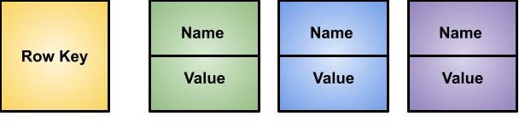
Column-based
A column-based database stores the data in columns instead of rows.
These column sets are known as column families, and users can directly query these column families without going through all the data records
Example:
They deliver high performance on aggregation queries like SUM, COUNT, AVG, MIN etc. as the data is readily available in a column.
Name | City | Gender
Raj | Rajkot | Male
Row Key
Name
City
Gender
Examples:
Accumulo
Cassandra
HBase
Raj
Rajkot
Male

Slide 12
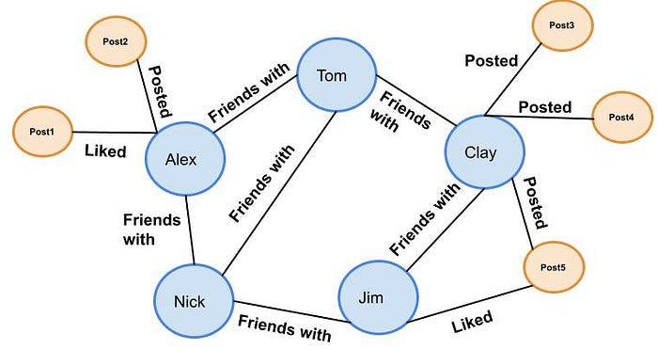
Graph-based
Graph-based databases focus on the relationship between the elements.
It stores the data in the form of nodes in the database.
The connections between the nodes are called links or relationships.
Example:
Every node and edge has a unique identifier.
Examples:
Neo4J
Infinite Graph
FlockDB

Slide 13
Advantages & Disadvantages of NoSQL
Section – 3

Slide 14
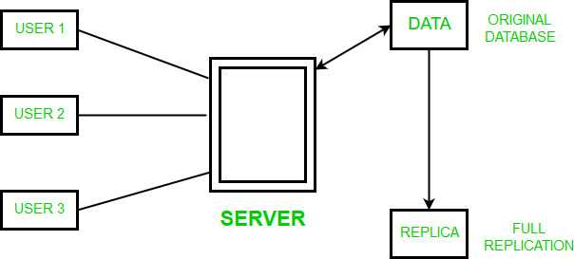
Advantages of NoSQL
Flexibility:
NoSQL databases are highly flexible as they can store and combine any type of data, both structured and unstructured, unlike relational databases that can store data in a structured way only.
Scalability:
NoSQL databases are highly scalable, which means that they can handle large amounts of data and traffic with ease.
This makes them a good fit for applications that need to handle large amounts of data or traffic.
High availability:
Auto replication feature in NoSQL databases makes it highly available because in case of any failure data replicates itself to the previous consistent state.

Slide 15
Advantages of NoSQL (Cont..)
High performance:
NoSQL databases are designed to handle large amounts of data and traffic, which means that they can offer improved performance compared to traditional relational databases.
Open-source (Cost savings):
NoSQL databases don’t require expensive licensing fees and can run on inexpensive hardware, rendering their deployment cost-effective.

Slide 16
Disadvantages of NoSQL
Lack of Standardization:
There is no standard that defines rules and roles of NoSQL databases.
Moreover, the design of this system changes between different NoSQL items.
Lack of ACID compliance:
NoSQL databases typically do not support ACID (Atomicity, Consistency, Isolation, Durability) transactions, which are a set of properties that guarantee the integrity and consistency of data in a database.
This can be a drawback for applications that require strong data consistency guarantees.
Backup of Database:
Backups are a drawback in NoSQL databases. Though some NoSQL databases like MongoDB provide some tools for backup, these tools are not mature enough to ensure proper complete data backup solution.
Lack of support for complex queries:
NoSQL databases are not designed to handle complex queries, which means that they are not a good fit for applications that require complex data analysis or reporting.
GUI is not available:
GUI mode tools to access the database are not flexibly available in the market.

Slide 17
When should NoSQL be used
Section – 4

Slide 18
When should NoSQL be used?
When a huge amount of data needs to be stored and retrieved.
The relationship between the data you store is not that important.
Storing and managing unstructured data, such as documents, images, and videos
The data changes over time and is not structured.
Support of Constraints and Joins is not required at the database level.
The data is growing continuously and you need to scale the database regularly to handle the data.
Building real-time, high-performance applications, such as mobile, web applications and IoT application

Slide 19
SQL v/s NoSQL
Parameter | SQL | NoSQL
Full Form | Structured Query Language | Not Only SQL
Type of Database | RDBMS or Relational Databases | Non-relational database or distributed database
Schema | These databases have fixed or static or predefined schema | They have a dynamic schema
Schema Type | These databases have fixed or static or predefined schema | They have a dynamic schema
Scalability | Vertically Scalable | Horizontally scalable
ACID Property | Follows ACID property | Follows CAP(consistency, availability, partition tolerance)
Joins | Support Joins | Does not support Joins
Complex queries | Support Complex queries | Does not support Complex queries
Normalization | Use normalized data structure | Use denormalized data structure
Examples | MySQL, PostgreSQL, Oracle, MS-SQL Server | MongoDB, GraphQL, HBase, Neo4j, Cassandra

Slide 20
Introduction to MongoDB
Section – 5

Slide 21
What is MongoDB?
MongoDB is an open-source document-oriented database that is designed to store a large scale of data.
It is categorized under the NoSQL (Not only SQL) database because the storage and retrieval of data in the MongoDB are not in the form of tables.
Nowadays there are so many companies that used MongoDB like Facebook, Nokia, eBay, Adobe, Google, etc. to store their large amount of data.

Slide 22
What is MongoDB?
MongoDB stores data in JSON-like documents and fields can vary from document to document.
The MongoDB database has a flexible data model that enables you to store unstructured data, and it provides full indexing support, and replication.
Instead of using tables and rows as in the traditional relational databases, MongoDB makes use of collections and documents.
Documents consist of key-value pairs which are the basic unit of data in MongoDB.
Collections contain sets of documents and function which is the equivalent of relational database tables.
{
“Name”:”Raj”,
“City”:”Rajkot”,
“Gender”:”Male”
}
{
“Name”:”Jiya”,
“City”:”Junagadh”,
“ContactNo”:”9825098555”
}
{
“Name”:”Harsh”,
“City”:”Junagadh”,
“Gender”:”Male”
“ContactNo”:”9825098590”
}

Slide 23
Document structure (JASON Example)
Simple JSON
Nested JSON
1
2
3
4
5
6
7
8
{
FirstName:"Naimish",
LastName:"Patel",
EmpID:"CENRV01",
Designation:"Asst. Prof.",
Mobile:123456,
Email:"nrv01@gmail.com"
}
1
2
3
4
5
6
7
8
9
10
11
12
13
{
FirstName:"Naimish",
LastName:"Patel",
EmpID:"CENRV01",
Designation:"Asst. Prof.",
Mobile:[123456,654321,987654],
Car:
{
Model:"Maruti Suzuki Swift",
Year:2021,
Color:"Red"
}
}

Slide 24
How MongoDB works?
The MongoDB database contains collections just like the SQL database contains tables.
You are allowed to create multiple databases and multiple collections.
Now inside of the collection we have documents.
These documents contain the data we want to store in the MongoDB database and a single collection can contain multiple documents and these are schema-less means it is not necessary that one document is similar to another.
The documents are created using the fields, these are key-value pairs in the documents, it is just like columns in the relation database.
The value of the fields can be of any BSON (Binary Javascript Object Notation) data types like double, string, boolean, etc.
The data stored in the MongoDB is in the format of BSON documents, In the backend, the MongoDB server converts the JSON data into a binary form that is known as BSON and this BSON is stored and queried more efficiently.

Slide 25
How MongoDB works?
In MongoDB documents, you are allowed to store nested data.
This nesting of data allows you to create complex relations between data and store them in the same document which makes the working and fetching of data extremely efficient as compared to SQL.
In SQL, you need to write complex joins to get the data from table 1 and table 2.
The maximum size of the BSON document is 16MB.

Slide 26
Features of MongoDB
Schema-less Database:
It is the great feature provided by the MongoDB.
A Schema-less database means one collection can hold different types of documents in it.
Or in other words, in the MongoDB database, a single collection can hold multiple documents and these documents may consist of the different numbers of fields, content, and size.
It is not necessary that the one document is similar to another document like in the relational databases.
Due to this feature, MongoDB provides great flexibility to databases.
Document Oriented:
In MongoDB, all the data stored in the documents instead of tables like in RDBMS.
In these documents, the data is stored in fields(key-value pair) instead of rows and columns which make the data much more flexible in comparison to RDBMS.
And each document contains its unique object id.
High Performance:
The performance of MongoDB is very high and data persistence as compared to another database due to its features like scalability, indexing, replication, etc.

Slide 27
Features of MongoDB
Indexing:
In MongoDB database, every field in the documents is indexed with primary and secondary indices this makes easier and takes less time to get or search data from the pool of the data.
If the data is not indexed, then database search each document with the specified query which takes lots of time and not so efficient.
Scalability:
MongoDB provides horizontal scalability with the help of sharding.
Sharding means to distribute data on multiple servers, here a large amount of data is partitioned into data chunks using the shard key, and these data chunks are evenly distributed across shards that reside across many physical servers, It will also add new machines to a running database.
Replication:
MongoDB provides high availability and redundancy with the help of replication, it creates multiple copies of the data and sends these copies to a different server so that if one server fails, then the data is retrieved from another server.
Aggregation:
It allows to perform operations on the grouped data and get a single result or computed result.

Slide 28
RDBMS v/s MongoDB
Section – 6

Slide 29
RDBMS v/s MongoDB
RDBMS | MongoDB
Database | Database
Table | Collection
Row/Record | Documents
Columns | Fields
Join | Embedded documents
Database
Collections
Collections
Document
Document
Document
Document
Document
Document

Slide 30
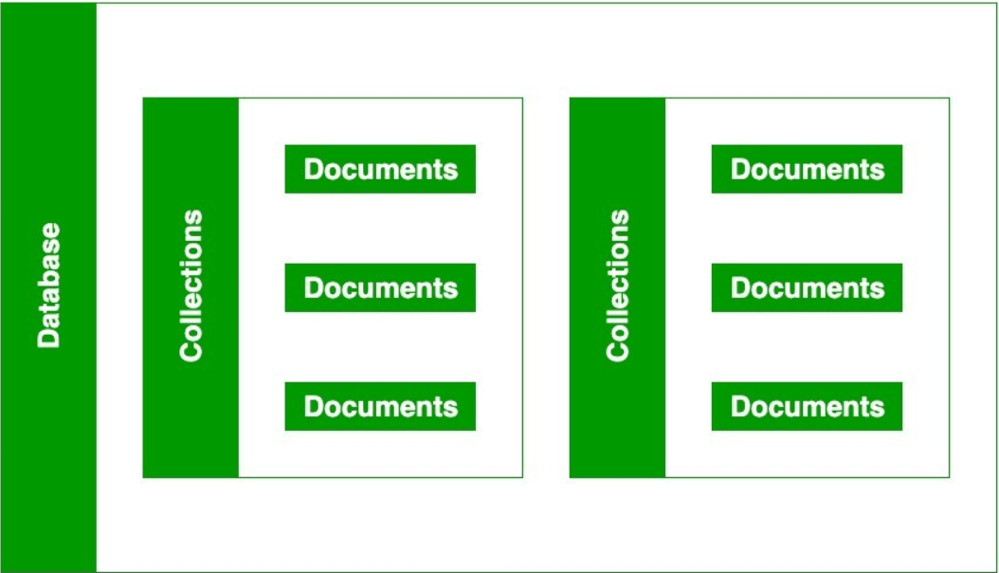
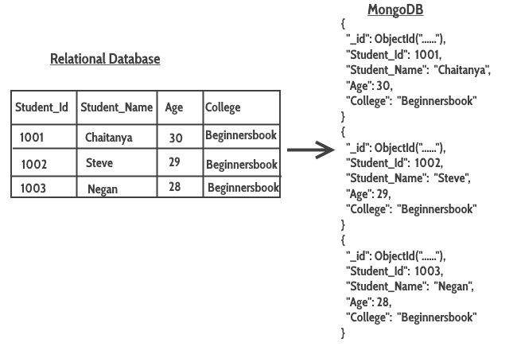
RDBMS v/s MongoDB

Slide 31

RDBMS v/s MongoDB
RDBMS | MongoDB
It is a relational database. | It is a non-relational and document-oriented database.
It is not suitable for hierarchical data storage. | It is suitable for hierarchical data storage.
It has a predefined schema. | It has a dynamic schema.
It centers around ACID properties (Atomicity, Consistency, Isolation, and Durability). | It centers around the CAP theorem (Consistency, Availability, and Partition tolerance).
In terms of performance, it is slower than MongoDB. | In terms of performance, it is much faster than RDBMS.
In this database, there is table, rows & columns. | It uses collection, documents & fields.
RDBMS supports complex joins. | MongoDB has no support for complex joins.
In RDBMS there is no by default index. | In MongoDB each field has been indexed.

Slide 32
Basic Database Commands, Operations & Methods
Section – 7

Slide 33
Datatypes and Operators
Section – 7.1

Slide 34
MongoDB Datatypes
Datatype | Description
String | String is the most commonly used datatype. It is used to store data. A string must be UTF 8 valid in mongodb.
Integer | Integer is used to store the numeric value. It can be 32 bit or 64 bit depending on the server you are using.
Boolean | This datatype is used to store Boolean values. It just shows YES/NO values.
Double | Double datatype stores floating point values.
Min/Max Keys | This datatype compare a value against the lowest and highest bson elements.
Arrays | This datatype is used to store a list or multiple values into a single key.
Object | Object datatype is used for embedded documents.
Null | It is used to store NULL values.
Symbol | It is generally used for languages that use a specific type.
Date | This datatype stores the current date or time in unix time format. It makes you possible to specify your own date time by creating object of date and pass the value of date, month, year into it.

Slide 35
MongoDB Operators
Operation | Operator | Description
Comparison: The following operators can be used in queries to compare values.
Equal | $eq | Select documents where the value of a field is equal to a specified value.
Not equal | $ne | Select documents where the value of a field is not equal to a specified value.
Greater than | $gt | Select documents where the value of a field is greater than a specified value.
Greater than equal | $gte | Select documents where the value of a field is greater than or equal to a specified value.
Less than | $lt | Select documents where the value of a field is less than a specified value.
Less than equal | $lte | Select documents where the value of a field is less than or equal to a specified value.
Values in an array | $in | Select documents where the value of a field equals any value in an array.
Values not in an array | $nin | Select documents where the value of a field doesn’t equal any value in an array.

Slide 36
MongoDB Operators
Operation | Operator | Description
Logical: The following operators can logically compare multiple queries.
Equal | $and | Returns documents where both conditions match (TRUE).
Not equal | $or | Returns documents where either condition match (TRUE).
Greater than | $nor | Returns documents where both conditions fail to match (TRUE).
Greater than equal | $not | Returns documents where the conditions does not match (TRUE).

Slide 37
Database, Collection, Document, Field
Section – 7.2

Slide 38
Database, Collection, Document, Field
RDBMS | MongoDB | Description
Database | Database | In MongoDB, databases hold one or more collections of documents.
Table | Collection | A collection in MongoDB is similar to a table in RDBMS. MongoDB collections do not enforce schemas. Each MongoDB collection can have multiple documents.
Row/Record | Documents | A record in MongoDB is a document, which is a data structure composed of field and value pairs.
Columns | Fields | Fields are analogous to columns in relational databases.

Slide 39
Basic Database Commands, Operations and Methods
Section – 7.3

Slide 40
Create Database
Create/Change Database
In MongoDB use command is used to create database.
The command will create a new database if it doesn't exist, otherwise it will return the existing database.
Show all databases (database list)
A database may not be listed. This is because the database is empty. An empty database is essentially non-existant.
To display database, you need to insert at least one document into it.
Check currently selected database
Syntax
Example
use DATABASE_NAME
use College
Syntax
show dbs
Syntax
db

Slide 41
Delete/Drop Database
Delete/Drop Database
Above syntax will delete the selected database.
If you have not selected any database, then it will delete default 'test' database.
Syntax
db.dropDatabase()

Slide 42
Create Collection [RDBMS: Table]
Create Collection
There are 2 methods to create a collection.
Method 1 (using createCollection)
We can create a collection using the createCollection() database method.
Method 2 (using insertOne or insertMany)
We can also create a collection during the insert process.
This will create the “college" collection if it does not already exist.
Display the created collection (collections list)
Syntax
Example
db.createCollection(“Collection_Name”)
db.createCollection(“Student")
Syntax
Example
db.Collection_Name.insertOne(Document)
db.Student.insertOne({“Name" : “Raj Mehta"})
Syntax
show collections

Slide 43
Create Collection with options [RDBMS: Table]
Create Collection with options
Syntax
db.createCollection(“Collection_Name”, options)
Example
db.createCollection(“college“, { capped : true, autoIndexID : true, size : 6142800, max : 10000 })
Option | Type | Description
capped | Boolean | (Optional) If true, enables a capped collection. Capped collection is a fixed size collection that automatically overwrites its oldest entries when it reaches its maximum size. If you specify true, you need to specify size parameter also.
autoIndexId | Boolean | (Optional) If true, automatically create index on _id field.s Default value is false.
size | number | (Optional) Specifies a maximum size in bytes for a capped collection. If capped is true, then you need to specify this field also.
max | number | (Optional) Specifies the maximum number of documents allowed in the capped collection.

Slide 44
Delete/Drop Collection
Delete/Drop Collection
Above syntax will delete the collection from the database.
It completely removes a collection from the database and does not leave any indexes associated with the dropped collections.
The db.Collection_Name.drop() method does not take any argument and produce an error when it is called with an argument.
Syntax
Example
db.Collection_Name.drop()
db.college.drop()

Slide 45
Rename Collection
Rename Collection
Above syntax will change the name of collection.
Syntax
Example
db.Collection_Name.renameCollection('New_Name')
db.college.renameCollection(‘collegedata')

Slide 46
Insert Documents [RDBMS: Row/Records]
Name | City | Gender
Raj | Rajkot | Male
Jiya | NULL | Female
Meet | Surat | NULL
Insert Documents
There are 2 methods to insert Documents into a Collection.
insertOne()
insertMany()
insertOne()
insertOne() method is used to inserts a single document into a collection.
insertMany()
insertMany() method is used to insert multiple documents into a collection.
Syntax
Syntax
db.Collection_Name.insertOne(Document)
db.Collection_Name.insertMany(Documents)
Example
Example
db.Student.insertOne({
Name: "Raj",
City: "Rajkot",
Gender: "Male"
})
db.Student.insertMany([{
Name: "Jiya", Gender: "Female"
},
{
Name: "Meet", City: "Surat"
}])

Slide 47
Insert Documents [RDBMS: Row/Records]
Name | City | Gender
Raj | Rajkot | Male
Jiya | NULL | Female
Meet | Surat | NULL
Name | MobileNo
Raj | 9871232345
Meet | 9898232345
Meet | 7096232345
insertOne()
insertMany()
Example
Example
db.Student.insertOne({
Name: "Raj",
City: "Rajkot",
Gender: "Male”,
MobileNo: 9871232345
})
db.Student.insertMany([{
Name: "Jiya",
Gender: "Female”,
},
{
Name: "Meet",
City: "Surat”,
MobileNo: [9871232345, 1234567890]
}])

Slide 48
Insert Documents [RDBMS: Row/Records]
Insert only ObjectId
Insert document with our own ObjectId (using insertOne() method)
Insert document with our own ObjectId (using insertMany() method)
Example
db.Student.insertOne({
})
Example
db.Student.insertMany([
{_id : 1, FirstName:”Neha”, SPI : 9.0 },
{_id : 2, FirstName:”Milan”, SPI : 9.5 },
{_id : 3, FirstName:”Sohan”, SPI : 8.6 }
])
Example
db.Student.insertOne({
_id : 1,
FirstName:”Nayan”,
SPI : 9.8
})

Slide 49
Exercise
MongoDB
Student
Exercise - 1
Rno | Name | Branch | Semester | CPI
101 | Ramesh | CE | 3 | 9
102 | Mahesh | EC | 3 | 8
103 | Suresh | NULL | NULL | NULL
104 | Amit | EE | 4 | 8
105 | Anita | CE | NULL | 8
106 | Reeta | NULL | 3 | 7
107 | Rohit | EE | 4 | 9
108 | Chetan | NULL | 3 | NULL
109 | Rakesh | CE | NULL | 9
Create a database named “College”.
Create a collection named “Student” using createCollection() method.
Insert first record (document) using insertOne() method.
Insert 2nd, 3rd and 4th record (document) using insertMany() method.
Insert 5th to 9th record (document) using insertMany() method.
Drop “Student” collection.
Exercise - 2
Create a collection named “Student” using insertOne() method. (Insert first record (document).
Insert second record (document) using insertOne() method.
Insert 3rd and 4th record (document) using insertMany() method.
Insert all remaining records (documents) using insertMany() method.
Drop “Student” collection.

Slide 50
find() [RDBMS: select]
find() method is used to retrieve documents from a collection.
Display all the documents of collection
Display documents of collection in formatted manner
Display only first 2 documents of a collection
db.Student.insertMany([
{_id : 1, FirstName : "Neha", SPI : 9.0, BL : 0 },
{_id : 2, FirstName : "Milan", SPI : 9.5, BL : 0 },
{_id : 3, FirstName : "Sohan", SPI : 8.6, BL : 1 },
{_id : 4, FirstName : "Nehal", SPI : 7.0, BL : 3 },
{_id : 5, FirstName : "Milani", SPI : 5.5, BL : 5 },
{_id : 6, FirstName : "Sohani", SPI : 8.0, BL : 2 }
])
Example
db.Student.find()
Example
db.Student.find().pretty()
Example
db.Student.find().limit(2)
The limit method is used to return the maximum number of documents from the query result.

Slide 51
find() [RDBMS: select]
Skip first document and display rest of documents of a collection
Display only 2nd and 3rd document of a collection
Display count of total documents of a collection
Example
db.Student.insertMany([
{_id : 1, FirstName : "Neha", SPI : 9.0, BL : 0 },
{_id : 2, FirstName : "Milan", SPI : 9.5, BL : 0 },
{_id : 3, FirstName : "Sohan", SPI : 8.6, BL : 1 },
{_id : 4, FirstName : "Nehal", SPI : 7.0, BL : 3 },
{_id : 5, FirstName : "Milani", SPI : 5.5, BL : 5 },
{_id : 6, FirstName : "Sohani", SPI : 8.0, BL : 2 }
])
db.Student.find().skip(1)
The skip method is used to skip the number of documents from the query result.
Example
db.Student.find().skip(1).limit(2)
Example
db.Student.find().count()

Slide 52
find() with filter [RDBMS: select with where]
Find students whose SPI = 9
Find students whose SPI <> 9
Find students whose SPI > 9
Find students whose SPI >= 9
Find students whose SPI < 9
Find students whose SPI <= 9
Example
Example
db.Student.find({ SPI : {$eq : 9} })
db.Student.find({ SPI : {$gte : 9} })
Example
Example
db.Student.find({ SPI : {$ne : 9} })
db.Student.find({ SPI : {$lt : 9} })
Example
Example
db.Student.find({ SPI : {$gt : 9} })
db.Student.find({ SPI : {$lte : 9} })

Slide 53
find() with filter and logical operator [RDBMS: select with where]
Find students whose SPI = 9 or BL = 0
Find students whose SPI > 9 or BL = 0
Find students whose SPI = 9 and BL = 0
Find students whose SPI > 9 and BL = 0
Example
Example
db.Student.find({
$or : [
{SPI : 9}, {BL : 0}
]
})
db.Student.find({
$and : [
{SPI : 9}, {BL : 0}
]
})
Example
Example
db.Student.find({
$or : [
{SPI : {$gt : 9}},
{BL : {$eq : 0}}
]
})
db.Student.find({
$and : [
{SPI : {$gte : 9}},
{BL : {$eq : 0}}
]
})

Slide 54
find() with filter and IN operator [RDBMS: select with where]
Find students where BL IN (0, 1)
Find students where BL NOT IN (0, 1)
Example
Example
db.Student.find({
BL: {$in: [0, 1]}
})
db.Student.find({
BL: {$nin: [0, 1]}
})

Slide 55
find() with filter and logical operator [RDBMS: select with where]
Find students whose _id > 2 and (SPI = 9 or BL = 0)
Find students whose _id > 2 and (SPI = 9 and BL = 0)
Example
Example
db.Student.find({
$and : [
{_id: {$gt : 2}},
{
$or : [{SPI : 9}, {BL : 0}]
}
]
})
db.Student.find({
$and : [
{_id: {$gt : 2}},
{
$and : [{SPI : 9}, {BL : 0}]
}
]
})

Slide 56
findOne() [RDBMS: select]
To retrieve first documents of collection
Display first document having SPI > 7
Example
db.Student.insertMany([
{_id : 1, FirstName : "Neha", SPI : 9.0, BL : 0 },
{_id : 2, FirstName : "Milan", SPI : 9.5, BL : 0 },
{_id : 3, FirstName : "Sohan", SPI : 8.6, BL : 1 },
{_id : 4, FirstName : "Nehal", SPI : 7.0, BL : 3 },
{_id : 5, FirstName : "Milani", SPI : 5.5, BL : 5 },
{_id : 6, FirstName : "Sohani", SPI : 8.0, BL : 2 }
])
db.Student.findOne()
Example
db.Student.findOne({ SPI : {$gt : 7} })

Slide 57
find() [RDBMS: select particular column]
To retrieve only FirstName field of collection
To retrieve only FirstName field and remove _id field of collection
To retrieve all the field except FirstName of collection
Example
db.Student.insertMany([
{_id : 1, FirstName : "Neha", SPI : 9.0, BL : 0 },
{_id : 2, FirstName : "Milan", SPI : 9.5, BL : 0 },
{_id : 3, FirstName : "Sohan", SPI : 8.6, BL : 1 },
{_id : 4, FirstName : "Nehal", SPI : 7.0, BL : 3 },
{_id : 5, FirstName : "Milani", SPI : 5.5, BL : 5 },
{_id : 6, FirstName : "Sohani", SPI : 8.0, BL : 2 }
])
db.Student.find({}, {FirstName: 1})
Example
db.Student.find({}, {_id: 0, FirstName: 1})
Example
db.Student.find({}, {FirstName: 0})

Slide 58
find() [RDBMS: select particular column with where]
To retrieve only FirstName field whose SPI > 8 of collection
db.Student.insertMany([
{_id : 1, FirstName : "Neha", SPI : 9.0, BL : 0 },
{_id : 2, FirstName : "Milan", SPI : 9.5, BL : 0 },
{_id : 3, FirstName : "Sohan", SPI : 8.6, BL : 1 },
{_id : 4, FirstName : "Nehal", SPI : 7.0, BL : 3 },
{_id : 5, FirstName : "Milani", SPI : 5.5, BL : 5 },
{_id : 6, FirstName : "Sohani", SPI : 8.0, BL : 2 }
])
Example
db.Student.find({ SPI : {$gt : 8} }, {FirstName: 1})

Slide 59
Exercise (Convert SQL query into MongoDB query)
MongoDB
Exercise
select * from student
db.student.find( )
select name, city, mobileno from student
db.student.find({ } , { _id : 0, name : 1, city : 1, mobileno : 1 })
select name from student where SPI>7
db.student.find({ SPI : { $gt : 7} } , {_id : 0, name : 1})
select name, dept from student where SPI>7 and Backlog<2
db.student.find({ $and: [{ SPI : { $gt : 7} } , { BL : { $lt : 2} } ] } , {_id : 0, name : 1, dept : 1})
select name, dept from student where dept in ('CE’, 'IT')
db.student.find({ dept: { $in : ['CE’, 'IT’] } } , {_id : 0, name : 1, dept : 1})

Slide 60
Exercise (Convert SQL query into MongoDB query)
MongoDB
Exercise
select name, dept from student where dept in ('CE’, 'IT') and Backlog=0
db.student.find( { Dept : { $in : [ 'CE’, 'IT’ ] } } , { _id : 0, name : 1, dept : 1 } )
select top 5 * from student
db.student.find( ).limit(5)
select top 5 * from student where rno>105 order by rno desc
db.student.find({ rno : { $gt : 105 } } ).sort( { rno : -1} ).limit(5)
sp_rename ‘student', 'student_data’
db.student.renameCollection(‘student_data’)
drop table student_data
db.student.drop()

Slide 61
sort() [RDBMS: order by]
sort() method is used to sort the documents in the collection. This method accepts a document containing list of fields along with their sorting order.
The sorting order is specified as 1 or -1.
1 is used for ascending order sorting.
-1 is used for descending order sorting.

Slide 62
sort() [RDBMS: order by]
To retrieve documents in ascending order on FirstName field.
To retrieve documents in descending order on FirstName field.
To retrieve documents in ascending order on BL field and descending order on SPI.
db.Student.insertMany([
{_id : 1, FirstName : "Neha", SPI : 9.0, BL : 0 },
{_id : 2, FirstName : "Milan", SPI : 9.5, BL : 0 },
{_id : 3, FirstName : "Sohan", SPI : 8.6, BL : 1 },
{_id : 4, FirstName : "Nehal", SPI : 7.0, BL : 3 },
{_id : 5, FirstName : "Milani", SPI : 5.5, BL : 5 },
{_id : 6, FirstName : "Sohani", SPI : 8.0, BL : 2 }
])
Example
db.Student.find().sort({FirstName : 1})
Example
db.Student.find().sort({FirstName : -1})
Example
db.Student.find().sort({BL : 1, SPI : -1})

Slide 63
Update Documents [RDBMS: Row/Records]
Name | City | Gender
Raj | Rajkot | Male
Jiya | Rajkot | Female
Meet | Surat | Male
Update Documents
There are 2 methods to update Documents of a Collection.
updateOne()
updateMany()
updateOne()
updateOne() method is used to update a single document into a collection.
updateMany()
updateMany() method is used to update multiple documents into a collection.
Syntax
Syntax
db.Collection_Name.updateOne(selection criteria, updated data)
db.Collection_Name.updateMany(selection criteria, updated data)
Example
Example
db.Student.updateOne(
{ City: “Rajkot" },
{ $set: { City: “Surat” } }
)
db.Student.updateMany(
{ Gender: “Male" },
{ $set: { Gender: “M” } }
)

Slide 64
Update Documents using upsert [RDBMS: Row/Records]
Update Documents using upsert
If you would like to insert the document if it is not found, you can use the upsert option.
Name | City | Gender
Raj | Rajkot | Male
Jiya | Rajkot | Female
Meet | Surat | Male
updateOne()
updateOne() method is used to update a single document into a collection.
updateMany()
updateMany() method is used to update multiple documents into a collection.
Syntax
Syntax
db.Collection_Name.updateOne(selection criteria, updated data)
db.Collection_Name.updateMany(selection criteria, updated data)
Example
Example
db.Student.updateOne(
{ City: “Jamnagar" },
{ $set: { City: “Surat” } },
{ upsert: true }
)
db.Student.updateMany(
{ Gender: “Mal" },
{ $set: { Gender: “M” } },
{ upsert: true }
)

Slide 65
Delete Documents [RDBMS: Row/Records]
Name | City | Gender
Raj | Rajkot | Male
Jiya | Rajkot | Female
Meet | Surat | Male
Delete Documents
There are 2 methods to delete Documents from a Collection.
deleteOne()
deleteMany()
deleteOne()
deleteOne() method is used to delete a single document from a collection.
deleteMany()
deleteMany() method is used to delete multiple documents from a collection.
Syntax
Syntax
db.Collection_Name.deleteOne(selection criteria)
db.Collection_Name.deleteMany(selection criteria)
Example
Example
db.Student.deleteOne(
{ City: “Rajkot" }
)
db.Student.deleteMany(
{ Gender: “Male" }
)

Slide 66
ObjectId [RDBMS: primary key]
Every document in the collection has an “_id” field that is used to uniquely identify the document in a particular collection it acts as the primary key for the documents in the collection.
“_id” field can be used in any format and the default format is ObjectId of the document.
An ObjectID is a 12-byte field of BSON type hexadecimal string.
Example: “64a6346d1d1f7d9abcc51c5f”
The first 4 bytes representing the Unix Timestamp of the document
The next 3 bytes are the machine Id on which the MongoDB server is running
The next 2 bytes are of process id
The last 3 bytes used for increment the objectid.
64a6346d | 1d1f7d | 9abc | c51c5f
Timestamp (4 byte) | Machine Id (3 byte) | Process id (2 byte) | Increment (3 byte)

Slide 67
Update Operators
Fields: The following operators can be used to update fields.
$currentDate: Sets the field value to the current date
$inc: Increments the field value
$rename: Renames the field
$set: Sets the value of a field
$unset: Removes the field from the document

Slide 68
$currentDate
This operator is used to set the value of a field to the current date (either as a timestamp or as a date).
The default type of $currentDate operator is a date.
You can use this operator in methods like update(), updateOne(), etc., according to your requirements.
This operator can also work with embedded/nested documents or arrays.
If the specified field is not found then this operator will add that field in the document.
emp
{_id : 1, FirstName : "Neha",
Joiningdate: 2022-07-10T05:31:14.168Z},
{_id : 2, FirstName : "Milan",
Joiningdate: 2022-07-10T05:31:14.168Z },
{_id : 3, FirstName : "Sohan",
Joiningdate: 2022-07-10T05:31:14.168Z }
Output
emp
{_id : 1, FirstName : "Neha",
Joiningdate: 2023-07-10T05:31:14.168Z},
{_id : 2, FirstName : "Milan",
Joiningdate: 2022-07-10T05:31:14.168Z },
{_id : 3, FirstName : "Sohan",
Joiningdate: 2022-07-10T05:31:14.168Z }
Example
db.emp.updateOne({FirstName:“Neha"},
{$currentDate: {Joiningdate : true}})

Slide 69
$inc
This operator is used to increase the values of the fields to the specified amount or to increase the field by the given value.
This operator accepts positive and negative values.
If the given field does not exist, then this operator will create field and set the value of that field.
This operator will generate an error, if you use this operator with null value field.
It is an atomic operation in a single document.
emp
{_id : 1, FirstName : "Neha", BL : 1,
Joiningdate: 2023-07-10T05:31:14.168Z},
{_id : 2, FirstName : "Milan", BL : 0,
Joiningdate: 2023-07-10T05:31:14.168Z },
{_id : 3, FirstName : "Sohan", BL : 2,
Joiningdate: 2023-07-10T05:31:14.168Z }
Output
emp
{_id : 1, FirstName : "Neha", BL : 11,
Joiningdate: 2023-07-10T05:31:14.168Z},
{_id : 2, FirstName : "Milan", BL : 0,
Joiningdate: 2023-07-10T05:31:14.168Z },
{_id : 3, FirstName : "Sohan", BL : 2,
Joiningdate: 2023-07-10T05:31:14.168Z }
Example
db.emp.updateOne({FirstName:“Neha"},
{$inc: {BL: 10}})

Slide 70
$rename
This operator is used to update the names of the fields with new names.
The new name of the field should be different from the existing name of the field.
If the specified field for renaming is not available, then this operator will do nothing.
emp
{_id : 1, FirstName : "Neha", BL : 1,
Joiningdate: 2023-07-10T05:31:14.168Z},
{_id : 2, FirstName : "Milan", BL : 0,
Joiningdate: 2023-07-10T05:31:14.168Z },
{_id : 3, FirstName : "Sohan", BL : 2,
Joiningdate: 2023-07-10T05:31:14.168Z }
Example
Output
emp
db.emp.updateOne({FirstName:“Neha"},
{$rename: {BL: “Backlog”}})
{_id : 1, FirstName : "Neha", Backlog : 1,
Joiningdate: 2023-07-10T05:31:14.168Z},
{_id : 2, FirstName : "Milan", BL : 0,
Joiningdate: 2023-07-10T05:31:14.168Z },
{_id : 3, FirstName : "Sohan", BL : 2,
Joiningdate: 2023-07-10T05:31:14.168Z }

Slide 71
$unset
This operator is used to delete a particular field.
The value specified in the $unset expression does not make any impact on the operation.
The $unset has no effect when the field does not exist in the document.
emp
{_id : 1, FirstName : "Neha", BL : 1,
Joiningdate: 2023-07-10T05:31:14.168Z},
{_id : 2, FirstName : "Milan", BL : 0,
Joiningdate: 2023-07-10T05:31:14.168Z },
{_id : 3, FirstName : "Sohan", BL : 2,
Joiningdate: 2023-07-10T05:31:14.168Z }
Example
Output
emp
db.emp.updateOne({FirstName:“Neha"},
{$unset: {BL: “”}})
{_id : 1, FirstName : "Neha",
Joiningdate: 2023-07-10T05:31:14.168Z},
{_id : 2, FirstName : "Milan", BL : 0,
Joiningdate: 2023-07-10T05:31:14.168Z },
{_id : 3, FirstName : "Sohan", BL : 2,
Joiningdate: 2023-07-10T05:31:14.168Z }

Slide 72
Database Management System-II (DBMS-II)
#2301CS401
Prof. Firoz A. Sherasiya
Computer Science & Engineering Department
firoz.sherasiya@darshan.ac.in
9879879861

